Slide 1


A quick introduction
Ian Watt, Code The City
Wikidata logo By Planemad - Own work, Public Domain, https://commons.wikimedia.org/w/index.php?curid=20650833

Slide 2
Introduction
Graph Databases
Key concepts
What is Wikidata?
Example data
Querying Wikidata with SPARQL
How to get involved
Useful resources

Slide 3
Graph Databases vs Relational Databases
RDBMS
Tables
Schema
Linking of tables
Normalisation
(Primary) keys
Table Joins
SQL
Graph DB
Nodes (items)
Edges (relationships)
Schema-less
Nodes and edges have properties
Ad hoc additions
SPARQL / CYPHER

Slide 4
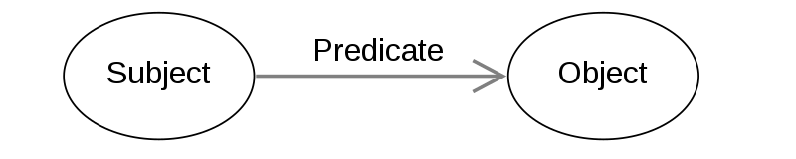
The RDF triple
In Linked Data we express the relationships as follows.
This Photo by Unknown Author is licensed under CC BY-SA
Applying this to our graph data we can say that Node A (subject) has a relation (predicate) of / to Node B (object)
RGU
Is an instance of
University
Is located at
Garthdee
RGU

Slide 5
Meet the family
Human
Is a
Is a
DOB: xx-xxx-xx
Eyes: Brown
Weight: xxx kg
DOB: xx-xxx-xx
Eyes: Blue
Height: xxx cm
Is a
Sue
Bob
Spouse
Has child
Rita
Has gender
Has child
Has pet
Cat
Male
Fritz
Is a
Female
Has gender
Has pet
Fur: Ginger
Weight: 5 kg
Notes:
This is a graph.
We call the Rita (Subject) Has a Pet (predicate) Fritz (object) a Triple in Graph language.

Slide 6
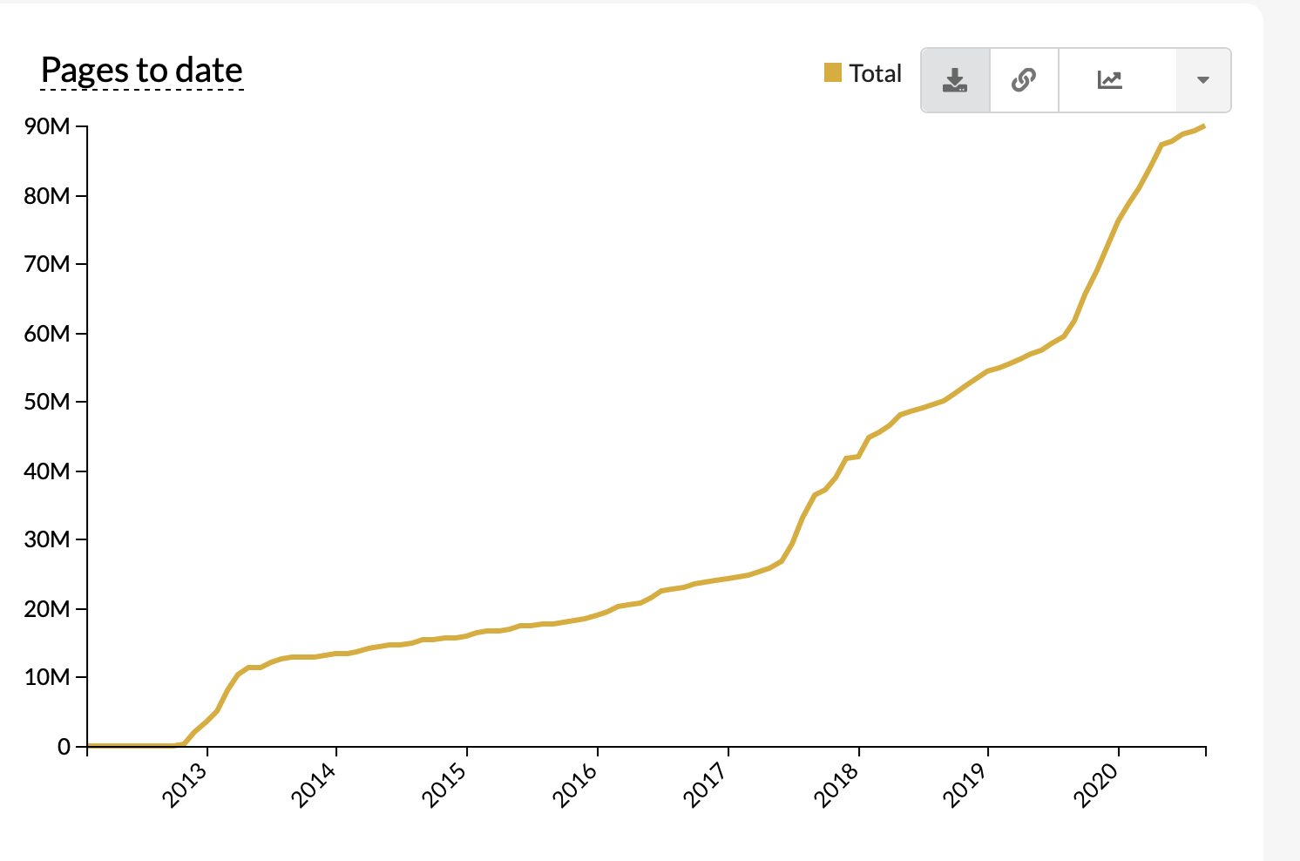
What is Wikidata?
Wikidata is a
collaboratively edited knowledge base
hosted by the Wikimedia Foundation.
common source of Linked Open Data
anyone can use, under a CC0 public domain license.
powered by the software Wikibase.
Main features:
Items (QID)
Properties (P number)
Statements (key-val pair)
https://www.wikidata.org/

Slide 7
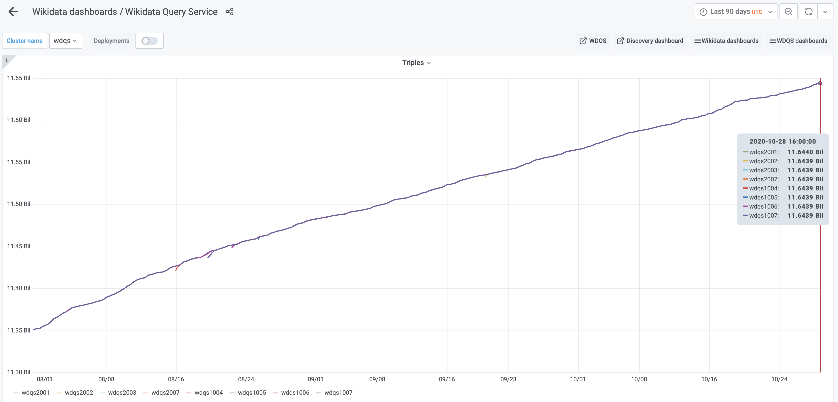
Wiki Data triples
Notes:
And on 4 March Wikidata reached 10 billion triples
Curretly at 11.64 billion.

Slide 8
Wikimedia Family
Wikipedia
Wikidata
Wiki Commons
Contains: Information
Licence: CC BY-SA 3.0
Contains: Media (images, video, sound)
Licence: CC0 / CC BY / CC BY-SA
Contains: Data
Licence: CC 0

Slide 9
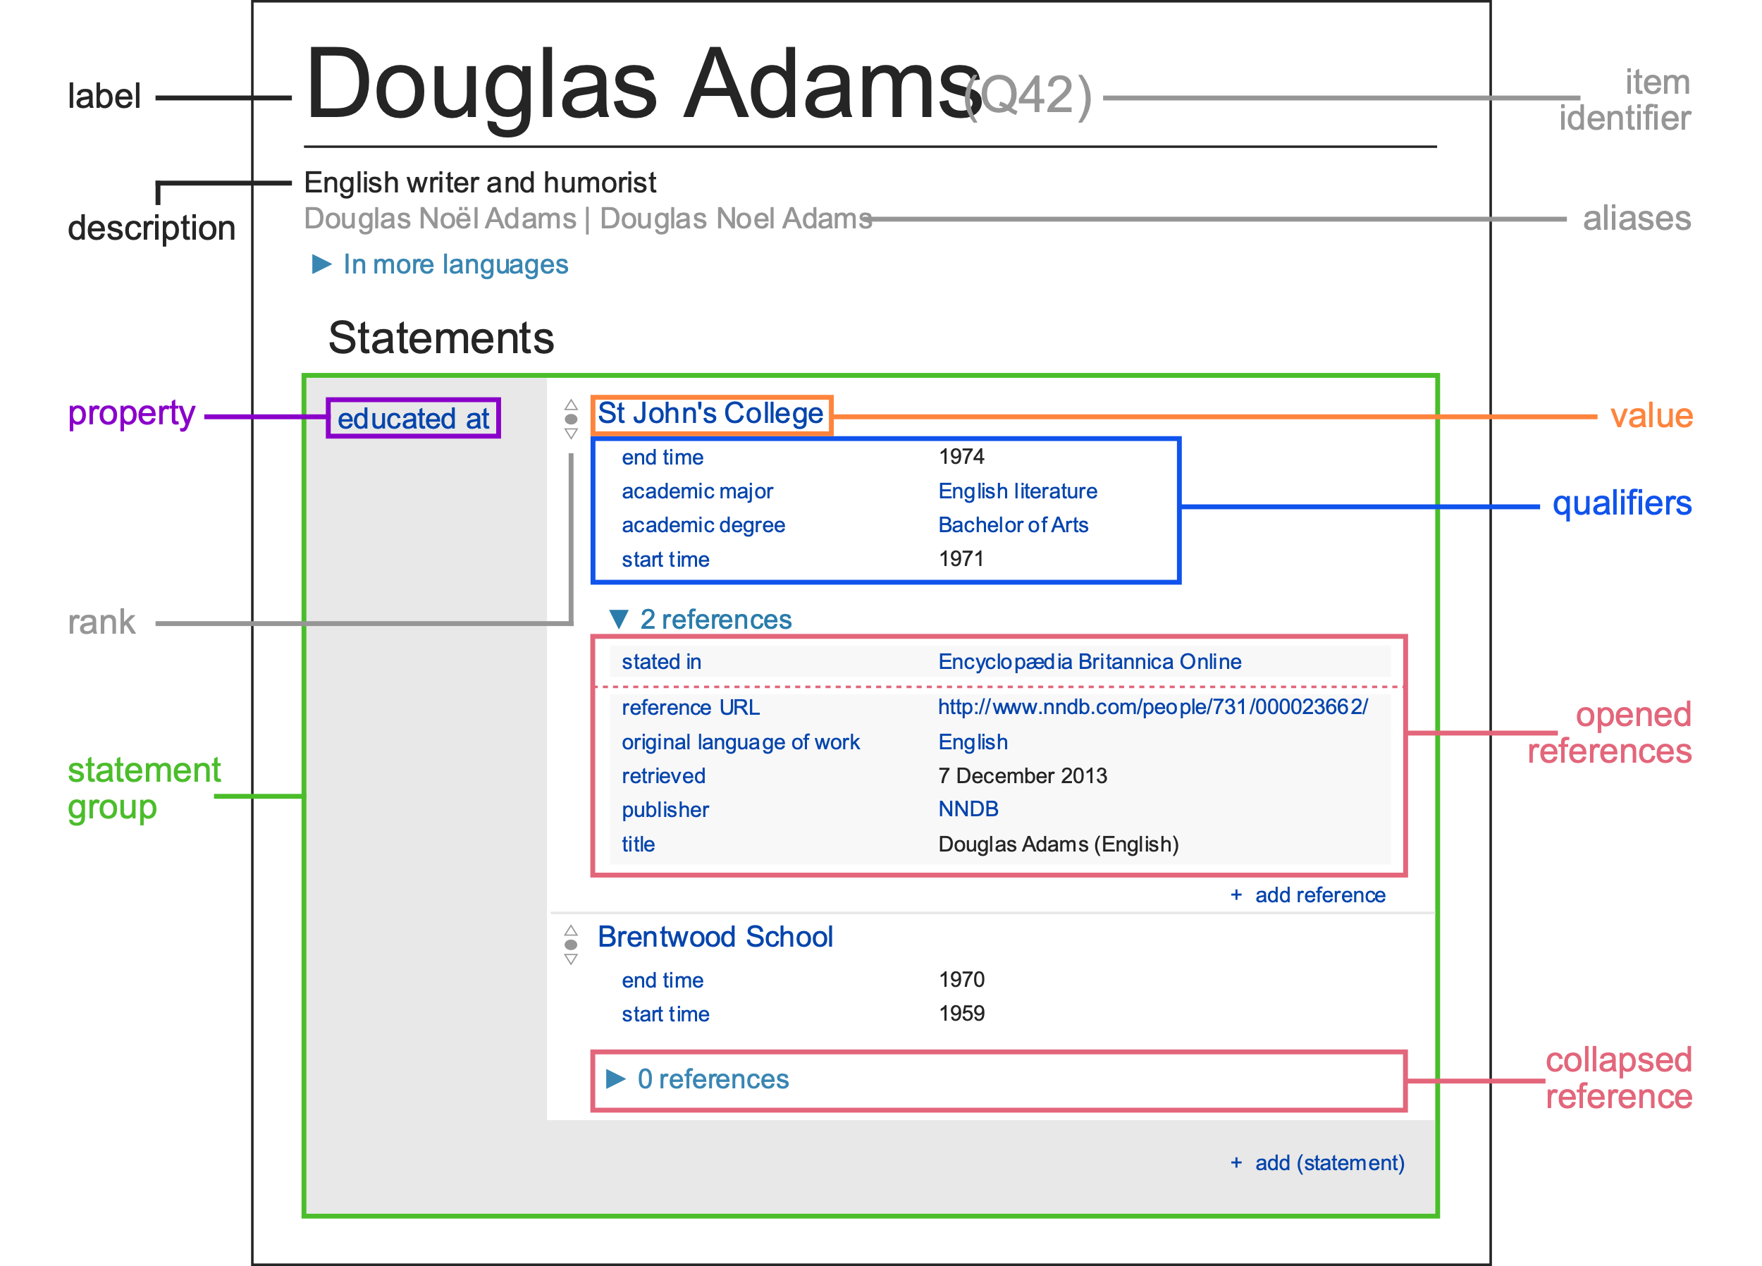
Example data
Wikidata items identified by QIDs
Q42
Graphic by Charlie Kritschmar (WMDE) - Own work, CC0, https://commons.wikimedia.org/w/index.php?curid=49616867

Slide 10
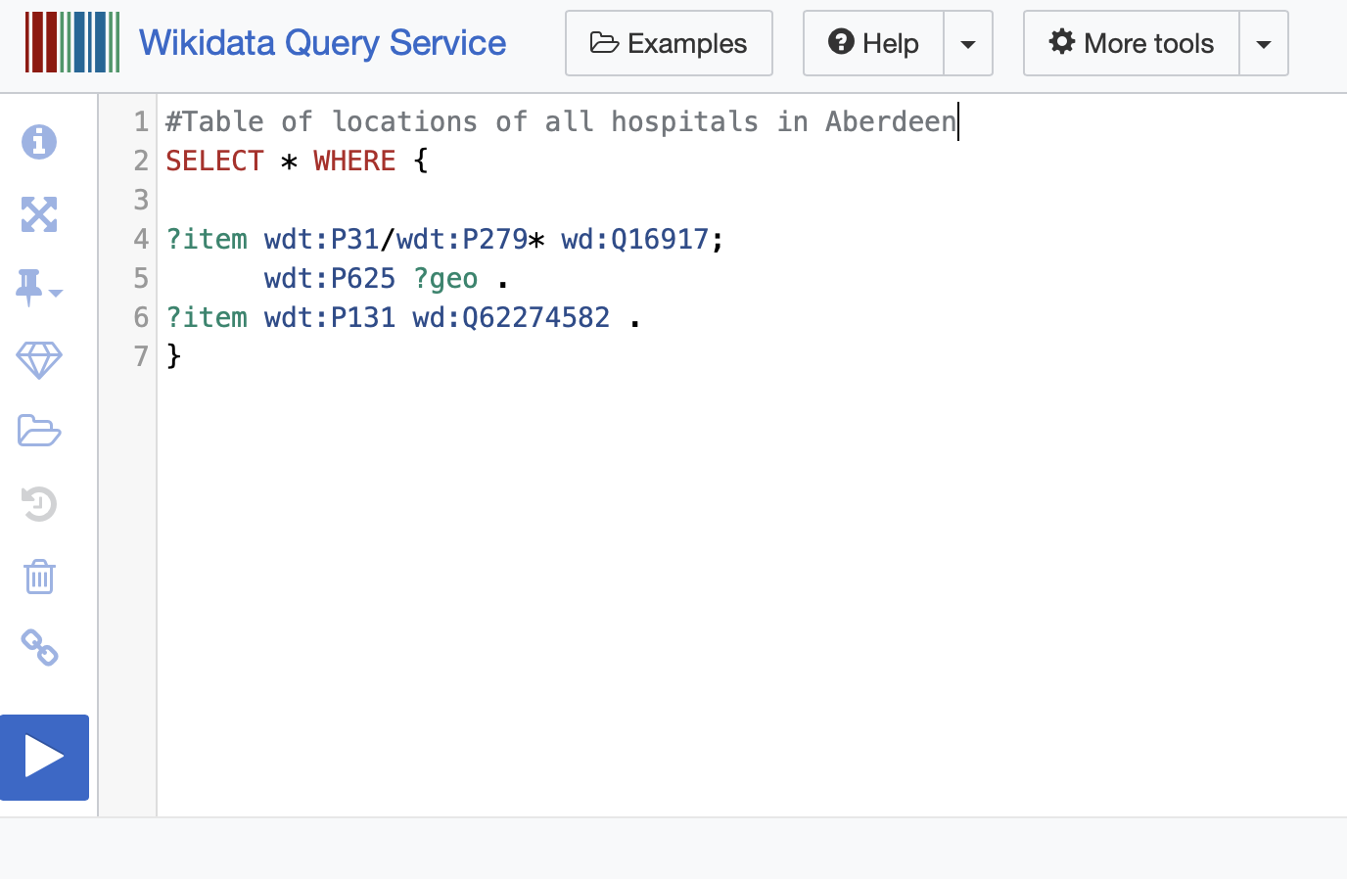
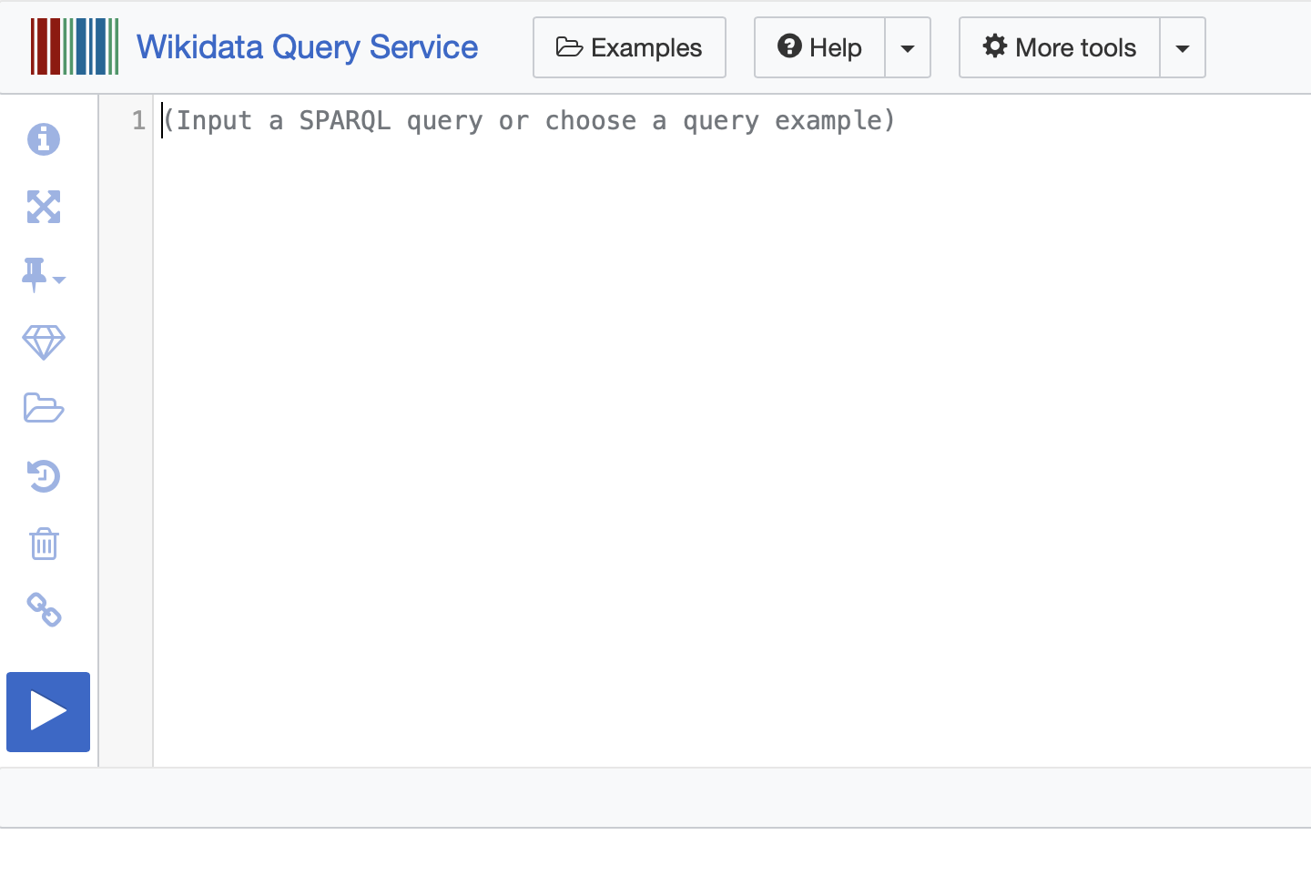
Querying Wikidata
https://query.wikidata.org
Useful example queries
Where we write our query
How we run our query

Slide 11
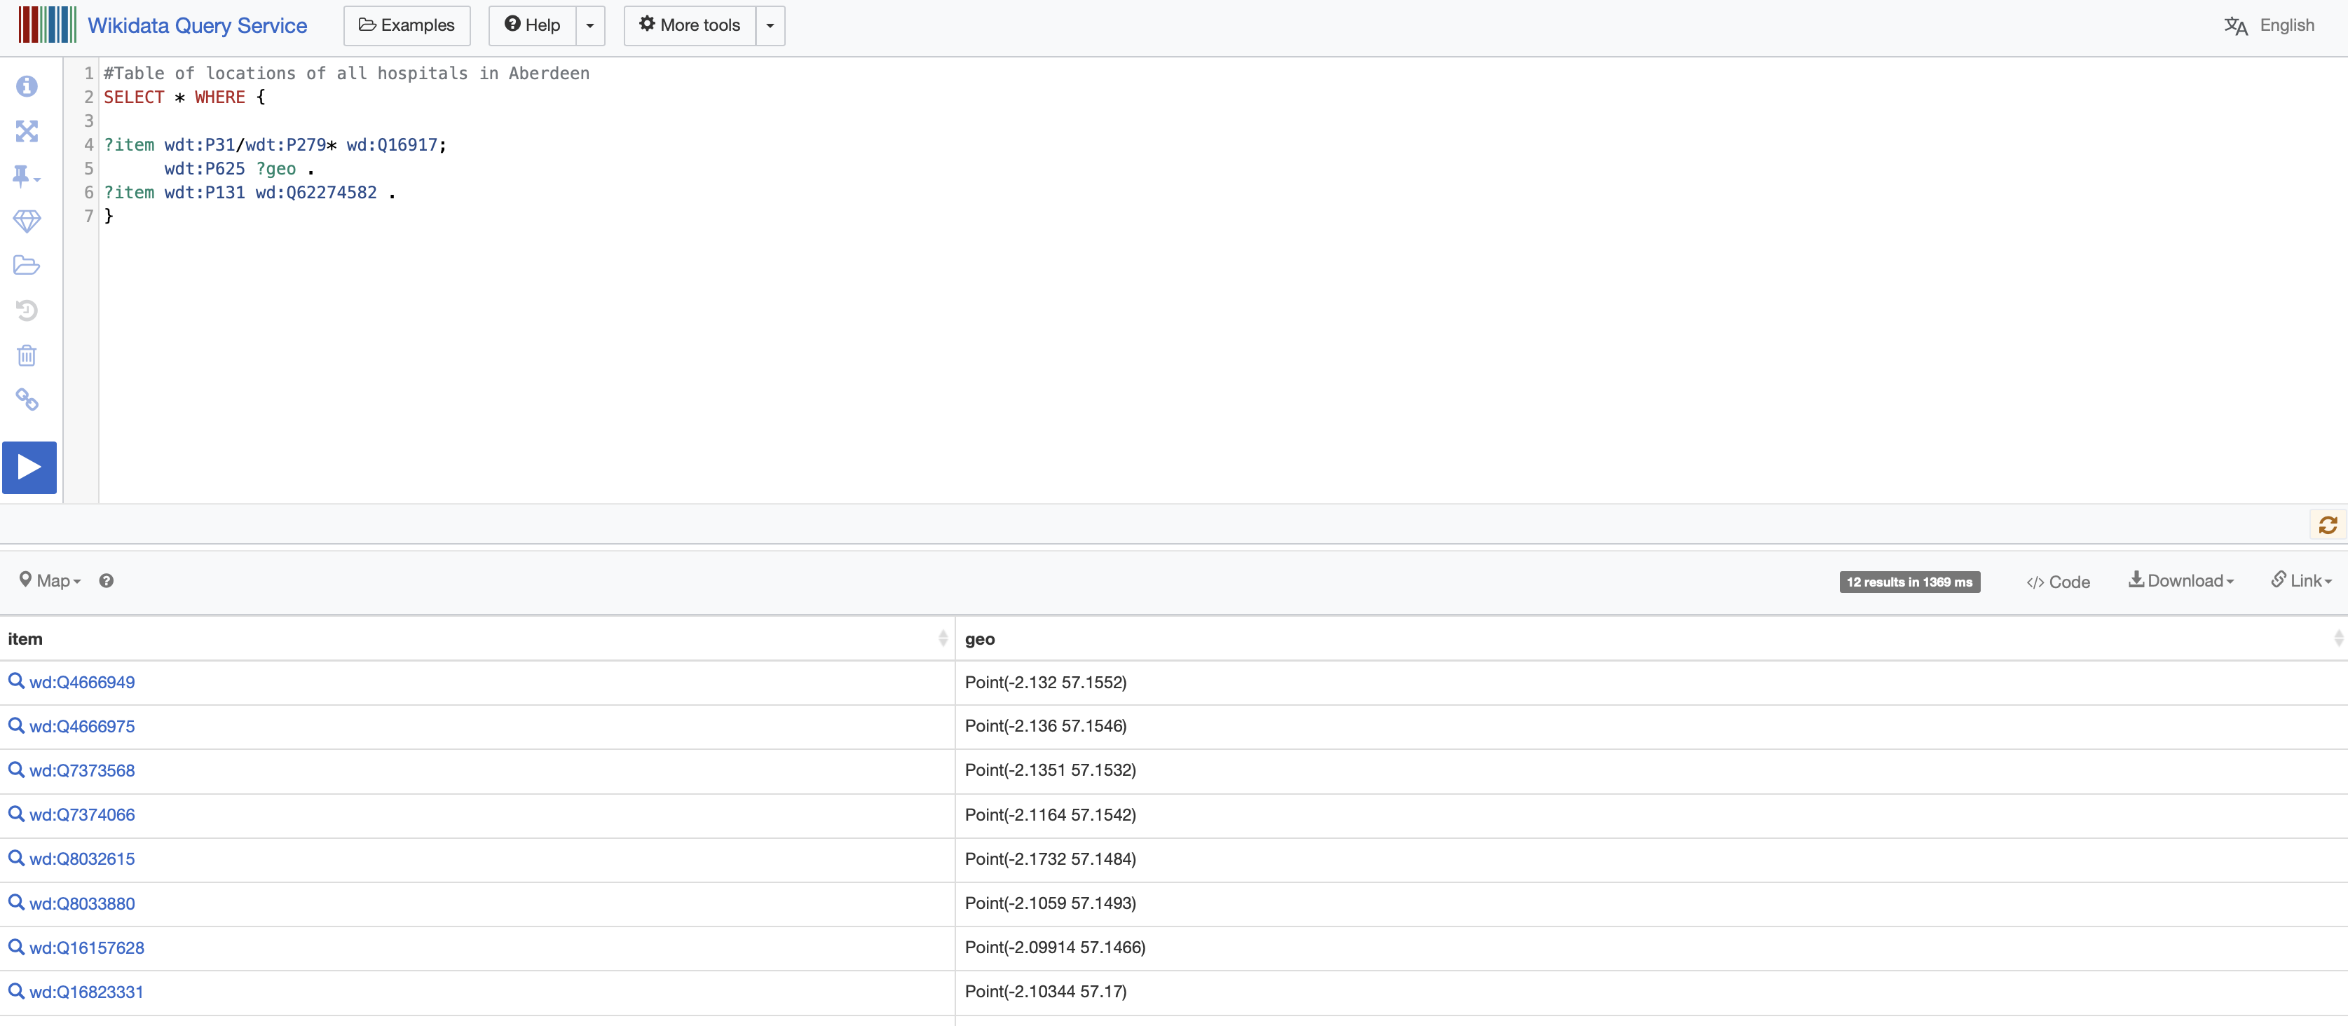
Results

Slide 12
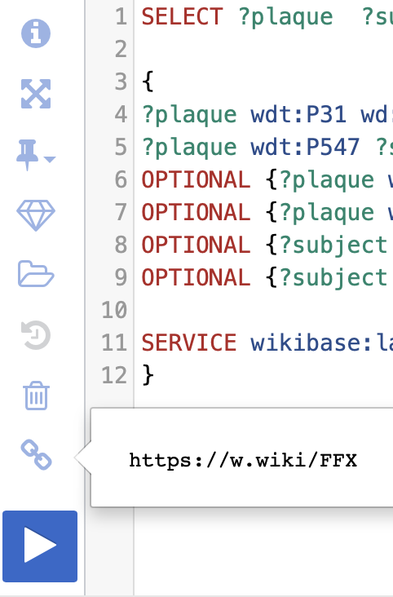
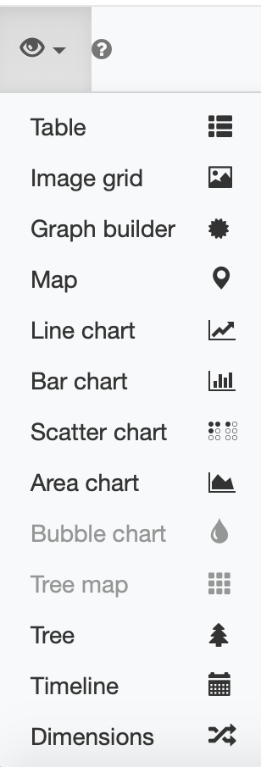
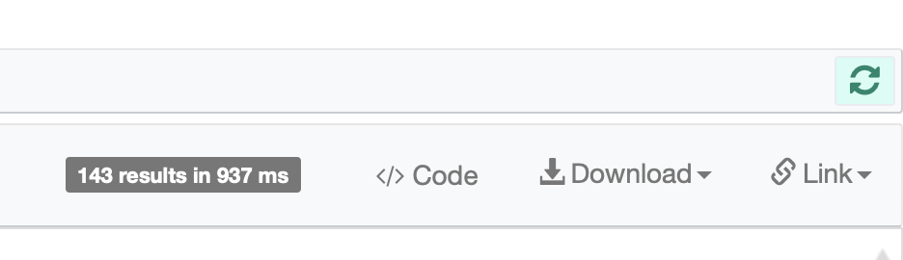
Results
Let’s write some queries!

Slide 13
Useful resources
Introduction to Graphs
NEW – Interactive WIKIDATA Query Service Tutorial
16-min SPARQL tutorial
Building SPARQL Queries (41 min tutorial)
Querying WIKIDATA with Python
Wikidata Integrator (Python library)
Lucas Werkmeister – Querying Wikidata with SPARQL
Timeline of Aberdeen Uni Graduates
Aberdeen Plaques – Part 1
Aberdeen Plaques – Part 2
Today’s slides: http://bit.do/IW_RGU_WIKIDATA

Slide 14
Getting involved
Sign up for a Wikidata account http://Wikidata.org
Come to Code The City events: https://codethecity.org
Sign up for the Code The City newsletter: http://eepurl.com/dNW2RA
Email: ian@codethecity.org
Twitter: @watty62

